Slide 1
Introduction to Computer Science and Programming
Lab 11 – C++ Functions
Laboratory 11, February 26, 2026
Muhammad Mohsin
DIBRIS, University of Genova

Slide 2
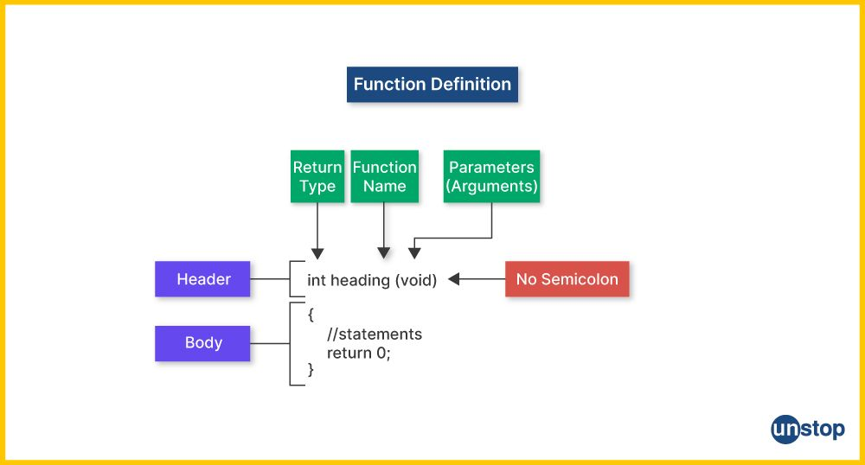
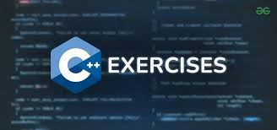
Today…
Today's lab is dedicated to functions exercises in C++.
The exercises are divided into two categories: easy ones for students who have never programmed before and more complex ones for students who already have programming experience. The recommendation is to read both and then start with the ones that seem most appropriate.
Notes:
Today we will do some simple exercises on using the computer

Slide 3
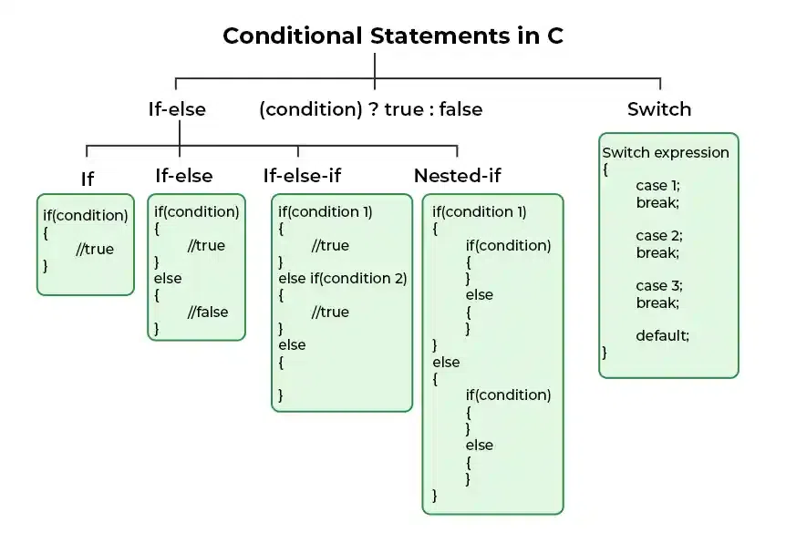
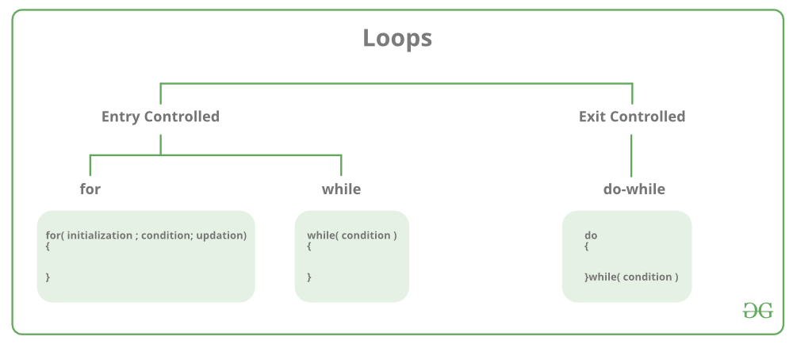
C++ language (commands covered so far)- Lecture Recap
Variables (local and global)
Basic datatypes
Int, float, double, char, …
Blocks
{ … }
Control flow commands
If, If-else, nested If, Ternary operator, Switch
Loops
For, While, Do-While
cout and cin commands
Strings
Today: Functions

Slide 4
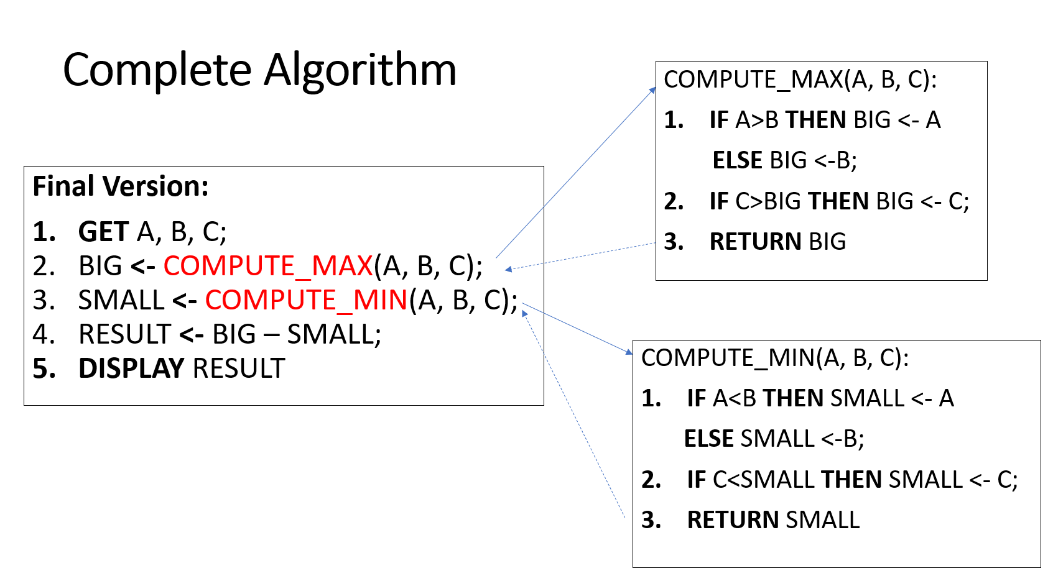
Function
Functions can be used to define reusable code and organize and simplify code
Concept already seen in the first lessons at level of Algorithm and EduBlocks
**Problem**: Given three integers, calculate the difference between the largest and the smallest
It is a portion of code to which we can give a name and call (invoke) it

Slide 5
Example
Find the sum of integers from 1 to 10, from 20 to 37, and from 35 to 49, respectively
int sum = 0;
for (int i = 1; i <= 10; i++)
sum += i;
cout << "Sum from 1 to 10 is " << sum << endl;
sum = 0;
for (int i = 20; i <= 37; i++)
sum += i;
cout << "Sum from 20 to 37 is " << sum << endl;
sum = 0;
for (int i = 35; i <= 49; i++)
sum += i;
cout << "Sum from 35 to 49 is " << sum << endl;
Write 3 loops

Slide 6
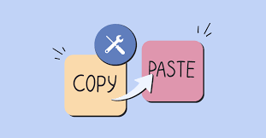
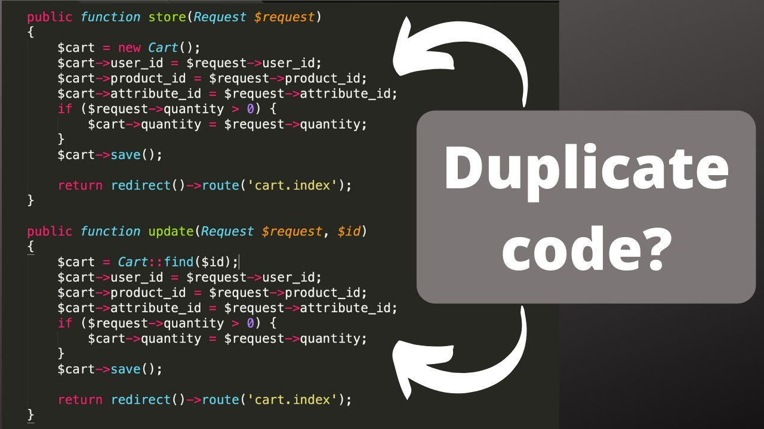

Duplicated code
Is it a good solution? NO!
A lot of duplicated code!!
Duplicated code is never a good solution because:
It makes the program longer than necessary and
It increases the risk of propagating errors in the code

Slide 7
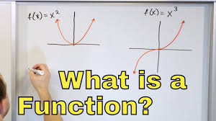
Defining a function
A function is a collection of statements that are grouped together to perform an operation with a name
A function definition consists of its function name, parameters, return type, and body

Slide 8
Function and Parameter Declaration
Notes:
Today we will do some simple exercises on using the computer

Slide 9
Function and Parameter Declaration
Function Declaration (Function Prototype)
A function declaration tells the compiler about the function's name, its return type, and the parameters it accepts. However, it does not include the actual implementation (body) of the function.
For Example : int sum(int a, int b);
Function declaration should always be before the main function
Notes:
Today we will do some simple exercises on using the computer

Slide 10
Function and Parameter Declaration
Function Definition
A function definition includes both the function header (same as the declaration) and the body, which contains the actual implementation of the function.
For Example :
int sum(int a, int b) {
int sum;
sum=a+b
return sum;
}
In function definition, should have function name, function parameters to be passed and a return type
Notes:
Today we will do some simple exercises on using the computer

Slide 11
Function and Parameter Declaration
Function Call
Declared functions are not executed immediately. They are "saved for later use", and will be executed later, when they are called.
To call a function, write the function's name followed by two parentheses () and a semicolon ;
Notes:
Today we will do some simple exercises on using the computer

Slide 12
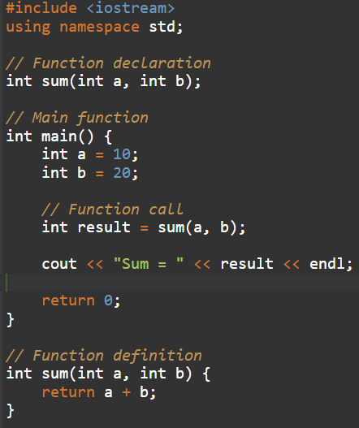
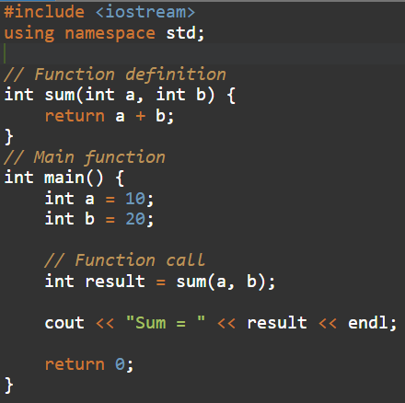
Example
Be careful, because with some compilers a function declared after its use might still work, but it is not standard
Notes:
Today we will do some simple exercises on using the computer

Slide 13
Exercise 1 (simple): Calculate the area of rectangle, triangle and cylinder using function overloading
Write a C++ program that defines a function to calculate the area of rectangle, triangle and cylinder using function overloading technique
Steps:
Define a function prototype
Create three function for each part to calculate the area using function overloading technique.
Call the function in main().
Example:
Input:
Length = 7
Width = 10
Base = 12
Height = 7, Radius = 3
Output:
Area of Rectangle: 70
Area of Triangle: 120
Area of Cylinder: 188.4
Notes:
#include<iostream>
using namespace std;
// Rectangle area
float areaRectangle(float l, float w) {
return l * w;
}
// Triangle area
float areaTriangle(float b, float h) {
return 0.5 * b * h;
}
// Cylinder area
float areaCylinder(float r, float h) {
float pi = 3.14;
return 2 * pi * r * (r + h);
}
int main() {
// Rectangle
cout << "Area of Rectangle = " << areaRectangle(7, 10) << endl;
// Triangle
cout << "Area of Triangle = " << areaTriangle(12, 20) << endl;
// Cylinder
cout << "Area of Cylinder = " << areaCylinder(3, 7) << endl;
return 0;
}
//A=2∗pi∗r∗(r+h)
//A=(1/2)∗b∗h
//A =l*w

Slide 14
Exercise 2 (simple): Check if a number is prime
Write a C++ program that defines a function called “isPrime” that takes an integer as a parameter and returns true if it's a prime number, otherwise false
Steps:
1. Define a function prototype for “isPrime”
2. Use loop to check divisibility from 2 to n-1
3. If the number has any divisors other than 1 and itself, return false
Hint: In main(), ask the user for a number, call the function, and display whether it’s prime or not
Example:
Input:
n = 14
Output: false
Notes:
#include <iostream>
using namespace std;
// Function prototype
bool isPrime(int n);
int main() {
int num;
// Asking the user for input
cout << "Enter an integer: ";
cin >> num;
// Calling the function and displaying the result
if (isPrime(num))
cout << "true" << endl;
else
cout << "false" << endl;
return 0;
}
// Function definition
bool isPrime(int n) {
if (n < 2)
return false; // Numbers less than 2 are not prime
for (int i = 2; i < n; i++) {
if (n % i == 0)
return false; // If n is divisible by any number other than 1 and itself, it's not prime
}
return true; // If no divisors found, n is prime
}

Slide 15
Exercise 3 (simple): Count the number of digits in an integer
Write C++ program that defines a function called “totalDigits” that takes an integer as input and returns the total number of digits in it.
Function should handle the zero input and negative, for example -987.
Example:
Number -987 has 3 digits
Number 0 has 1 digits
Number 7 has 1 digits
Notes:
#include<iostream>
using namespace std;
int totalDigits(int num) {
// Handle negative numbers
if (num < 0) {
num = -num; // Make it positive
}
// Handle 0 separately
if (num == 0) {
return 1;
}
int count = 0;
while (num > 0) {
num = num / 10; // Remove last digit
count++; // Increment counter
}
return count;
}
int main() {
cout << "Number 12345 has " << totalDigits(12345) << " digits" << endl;
cout << "Number -987 has " << totalDigits(-987) << " digits" << endl;
cout << "Number 0 has " << totalDigits(0) << " digits" << endl;
cout << "Number 7 has " << totalDigits(7) << " digits" << endl;
return 0;
}

Slide 16
Exercise 4 (simple): Calculator
Create a C++ calculator that takes a number, a basic math operator (+,-,*,/,^), and a second number all from user input, and have it print the result of the mathematical operation. The mathematical operations should be wrapped inside of functions
It is important to handle error cases when a symbol that does not represent an operation (e.g., &) is entered, terminating the program using the exit() command as discussed in class
Example:
Input:
n1 = 2
Op = ‘+’
n2 = 3
Output: 5
Notes:
#include <iostream>
#include <cmath> // For pow function
#include <cstdlib> // For exit function
using namespace std;
// Function prototypes
double add(double a, double b);
double subtract(double a, double b);
double multiply(double a, double b);
double divide(double a, double b);
double power(double a, double b);
int main() {
double num1, num2;
char op;
// Taking user input
cout << "Enter first number: ";
cin >> num1;
cout << "Enter an operator (+, -, *, /, ^): ";
cin >> op;
cout << "Enter second number: ";
cin >> num2;
// Performing calculation
double result;
switch (op) {
case '+': result = add(num1, num2); break;
case '-': result = subtract(num1, num2); break;
case '*': result = multiply(num1, num2); break;
case '/':
if (num2 == 0) {
cerr << "Error: Division by zero!\n";
exit(1);
}
result = divide(num1, num2);
break;
case '^': result = power(num1, num2); break;
default:
cerr << "Error: Invalid operator!\n";
exit(1);
}
// Printing result
cout << "Result: " << result << endl;
return 0;
}
// Function definitions
double add(double a, double b) { return a + b; }
double subtract(double a, double b) { return a - b; }
double multiply(double a, double b) { return a * b; }
double divide(double a, double b) { return a / b; }
double power(double a, double b) { return pow(a, b); }

Slide 17
Exercise 5 (Simple): Subsequence
Write a C++ program that defines a function to check if whether a given string is a subsequence of another given string.
Return 1 for true and 0 for false.
Example:
Input:
word3: ACGGTGTCGTGCTATGCTGATGCTGACTTATATGCTA subse3: CGTTCGGCTATGCTTCTACTTATTCTA
Output:
Is subse3 is the subsequence of word3? 1
Notes:
#include <iostream> // Input/output stream library
#include <algorithm> // Standard algorithm library for operations on sequences
using namespace std; // Using the standard namespace
// Function to check if 'subse' is a subsequence of 'word'
bool is_Subsequence(string subse, string word) {
int j = 0; // Initialize index for 'word'
for (int i = 0; i < subse.size(); i++) { // Loop through characters of 'subse'
if (word[j] == subse[i]) // If characters match
j++; // Move to the next character in 'word'
}
// Return true if all characters in 'subse' found in 'word' in order, else return false
return (j == word.size()) ? true : false;
}
int main() {
// Test cases
string word1 = "apple";
string subse1 = "apl";
cout << "word1: " << word1;
cout << "\nsubse1: " << subse1;
cout << "\nIs subse1 the subsequence of word1? " << is_Subsequence(word1, subse1);
string word2 = "apple";
string subse2 = "ppe";
cout << "\n\nword2: " << word2;
cout << "\nsubse2: " << subse2;
cout << "\nIs subse2 the subsequence of word2? " << is_Subsequence(word2, subse2);
string word3 = "ACGGTGTCGTGCTATGCTGATGCTGACTTATATGCTA";
string subse3 = "CGTTCGGCTATGCTTCTACTTATTCTA";
cout << "\n\nword3: " << word3;
cout << "\nsubse3: " << subse3;
cout << "\nIs subse3 the subsequence of word3? " << is_Subsequence(word3, subse3);
string word4 = "CGTTCGGCTATCGTACGTTCTATTCTATGATTTCTAA";
string subse4 = "CGTTCGGCTATGCZTTCTACTTATTCTA";
cout << "\n\nword4: " << word4;
cout << "\nsubse4: " << subse4;
cout << "\nIs subse4 the subsequence of word4? " << is_Subsequence(word4, subse4);
return 0; // Return 0 to indicate successful completion
}

Slide 18
Exercise 6 (More Complex): Add two binary numbers
Write a C++ program that defines a function that takes two binary numbers as input, adds them together, and return the result
Hint: represent binary numbers with strings (data type)
Example:
Input:
Enter the first binary number: 000011010
Enter the second binary number: 011100001
Output:
Sum of the binary numbers: 011111011
Notes:
#include <iostream>
#include <algorithm>
using namespace std;
// Function definition
string addBinary(string a, string b) {
string result = "";
int carry = 0;
int i = a.length() - 1;
int j = b.length() - 1;
while (i >= 0 || j >= 0 || carry) {
int sum = carry;
if (i >= 0) {
sum += a[i] - '0'; // Convert char to int
i--;
}
if (j >= 0) {
sum += b[j] - '0'; // Convert char to int
j--;
}
result += (sum % 2) + '0'; // Convert int to char
carry = sum / 2;
}
reverse(result.begin(), result.end());
return result;
}
int main() {
string binary1, binary2;
cout << "Enter the first binary number: ";
cin >> binary1;
cout << "Enter the second binary number: ";
cin >> binary2; string sum = addBinary(binary1, binary2); cout << "Sum of the binary numbers: " << sum << endl;
return 0;
}

Slide 19
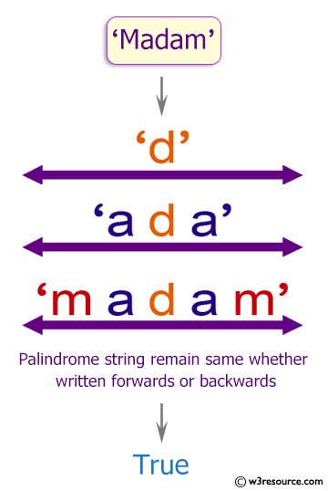
Exercise 7 (More Complex): Palindrome
Write a C++ function to check if a given string is a Palindrome or not.
A palindrome is a word, number, phrase, or other sequence of characters which reads the same backward as forward, such as madam, racecar
Example:
Input:
madam
Output:
True
Notes:
#include <iostream> // Including input/output stream library
using namespace std; // Using the standard namespace
// Function to test if a string is a palindrome
string test_Palindrome(string text) {
string str1, str2; // Declare two strings to store processed characters
int str_len = int(text.size()); // Calculate the length of the input string
// Loop through the string to form two strings containing only lowercase alphabets
for (int i = 0; i < str_len; i++) {
// Check if the character is an alphabet (case-insensitive) and add it to str1
if ((text[i] >= 'a' && text[i] <= 'z') || (text[i] >= 'A' && text[i] <= 'Z'))
str1 += tolower(text[i]);
// Check if the character (from the end of the string) is an alphabet and add it to str2
if ((text[str_len - 1 - i] >= 'a' && text[str_len - 1 - i] <= 'z') || (text[str_len - 1 - i] >= 'A' && text[str_len - 1 - i] <= 'Z'))
str2 += tolower(text[str_len - 1 - i]);
}
// Check if the processed strings str1 and str2 are equal (if the input string is a palindrome)
if (str1 == str2)
return "True"; // Return "True" if the string is a palindrome
return "False"; // Return "False" if the string is not a palindrome
}
// Main function
int main() {
// Output the result of testing strings for being palindromes
cout << "Is madam a Palindrome? " << test_Palindrome("madam");
cout << "\nIs racecar a Palindrome? " << test_Palindrome("racecar");
cout << "\nIs abc a Palindrome? " << test_Palindrome("abc");
return 0; // Return 0 to indicate successful completion

Slide 20
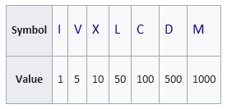
Exercise 8 (More Complex): Roman numeral conversion
Write a C++ function to convert a given integer to a Roman numeral
From Wikipedia:
Roman numerals are a numeral system that originated in ancient Rome and remained the usual way of writing numbers throughout Europe well into the Late Middle Ages. Numbers in this system are represented by combinations of letters from the Latin alphabet.
Example:
Input:
n: 7
Output:
VII
Notes:
#include <iostream>
using namespace std;
// Function to convert an integer to its Roman numeral representation
string integer_to_Roman(int n) {
// Arrays holding Roman numeral symbols and their respective values
string str_romans[] = {"M", "CM", "D", "CD", "C", "XC", "L", "XL", "X", "IX", "V", "IV", "I"};
int values[] = {1000, 900, 500, 400, 100, 90, 50, 40, 10, 9, 5, 4, 1};
// Initialize an empty string to hold the resulting Roman numeral
string result = "";
// Loop through the values and corresponding Roman symbols
for (auto i = 0; i < 13; ++i)
{
// While the current number is greater than or equal to the value
while(n - values[i] >= 0)
{
// Append the Roman symbol to the result and subtract the value from the number
result += str_romans[i];
n -= values[i];
}
}
// Return the resulting Roman numeral
return result;
}
// Main function to test the integer_to_Roman function
int main()
{
// Test cases to convert integers to Roman numerals using the integer_to_Roman function
int n = 7;
cout << "Integer " << n << " : Roman " << integer_to_Roman(7) << endl;
n = 19;
cout << "Integer " << n << " : Roman " << integer_to_Roman(19) << endl;
n = 789;
cout << "Integer " << n << " : Roman " << integer_to_Roman(789) << endl;
n = 1099;
cout << "Integer " << n << " : Roman " << integer_to_Roman(1099) << endl;
n = 23456;
cout << "Integer " << n << " : Roman " << integer_to_Roman(23456) << endl;
return 0;
}

